Slide 1

Multi-Functional Calculator
Presented by: Richa Soni
Under the guidance of: Ms. Naina Devi
Subject: C Programming

Slide 2
Agenda
01
02
Introduction
Tools and Technologies
Overview of the multi-functional calculator project
Programming environment and resources utilised
03
04
Project Working
Applications
Demonstration and implementation details
Real-world use cases and scenarios
05
06
Advantages
Future Scope
Key benefits and strengths
Potential enhancements and extensions

Slide 3

Introduction
The Multi-Functional Calculator is a comprehensive C programming project designed to perform a wide range of mathematical operations efficiently. This console-based application demonstrates fundamental programming concepts whilst providing practical utility.
Built entirely in C language, the calculator handles basic arithmetic operations, advanced scientific calculations, and specialised mathematical functions. It serves as an excellent demonstration of modular programming, user input validation, and control structures in C.
This project showcases the versatility of C programming in creating functional, user-friendly applications for everyday computational needs.

Slide 4




Tools and Technologies
Programming Language
Compiler
C Language - Core programming language for implementation
GCC Compiler - GNU Compiler Collection for building the application
Operating System
Development Environment
Windows / Linux - Cross-platform compatible development environment
Code::Blocks / VS Code - Integrated development environment for coding
Additional tools include the standard C library (stdio.h, math.h) for mathematical functions and input/output operations.

Slide 5




Project Description
The Multi-Functional Calculator is an interactive console application that accepts user input through a menu-driven interface. Users can select from various mathematical operations by entering the corresponding numerical choice.
Input Handling
Menu selection and numerical values entered by user
Processing
Calculation performed using C functions and operators
Output Display
Results displayed on console with proper formatting
The programme includes error handling mechanisms to manage invalid inputs and mathematical errors such as division by zero, ensuring robust operation.

Slide 6
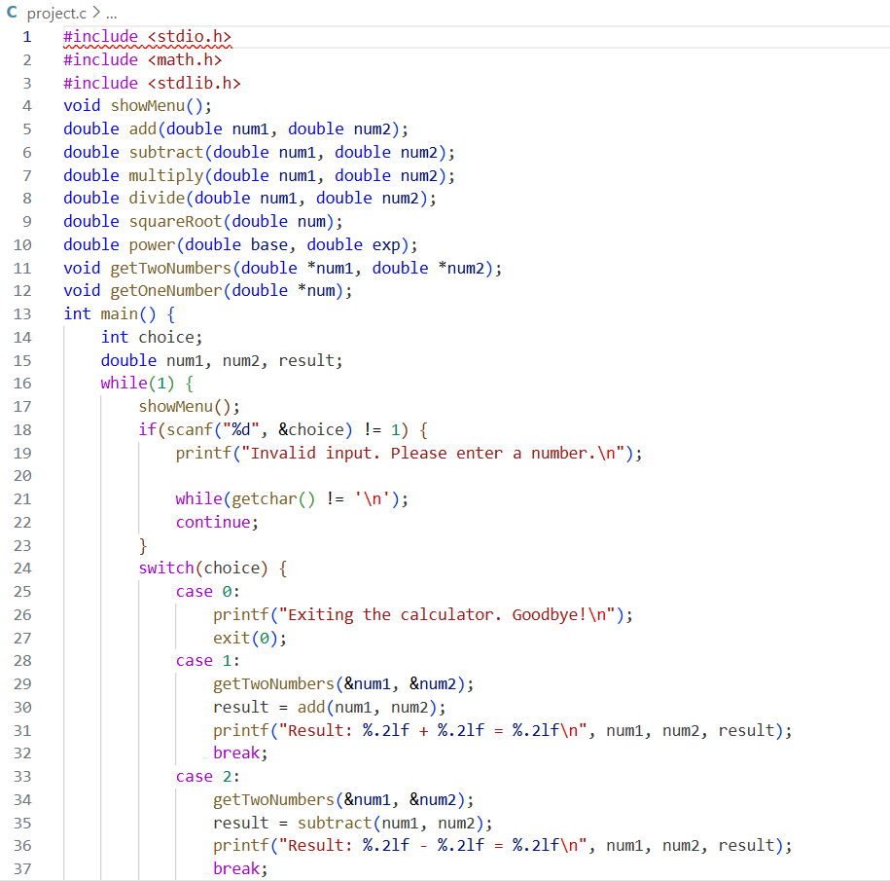
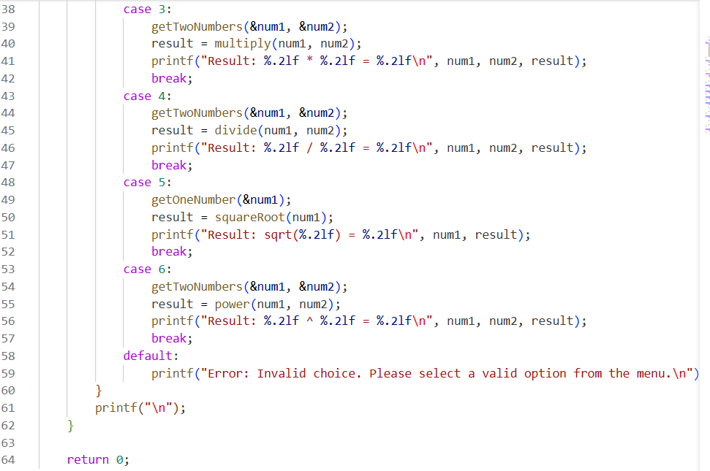

Slide 7
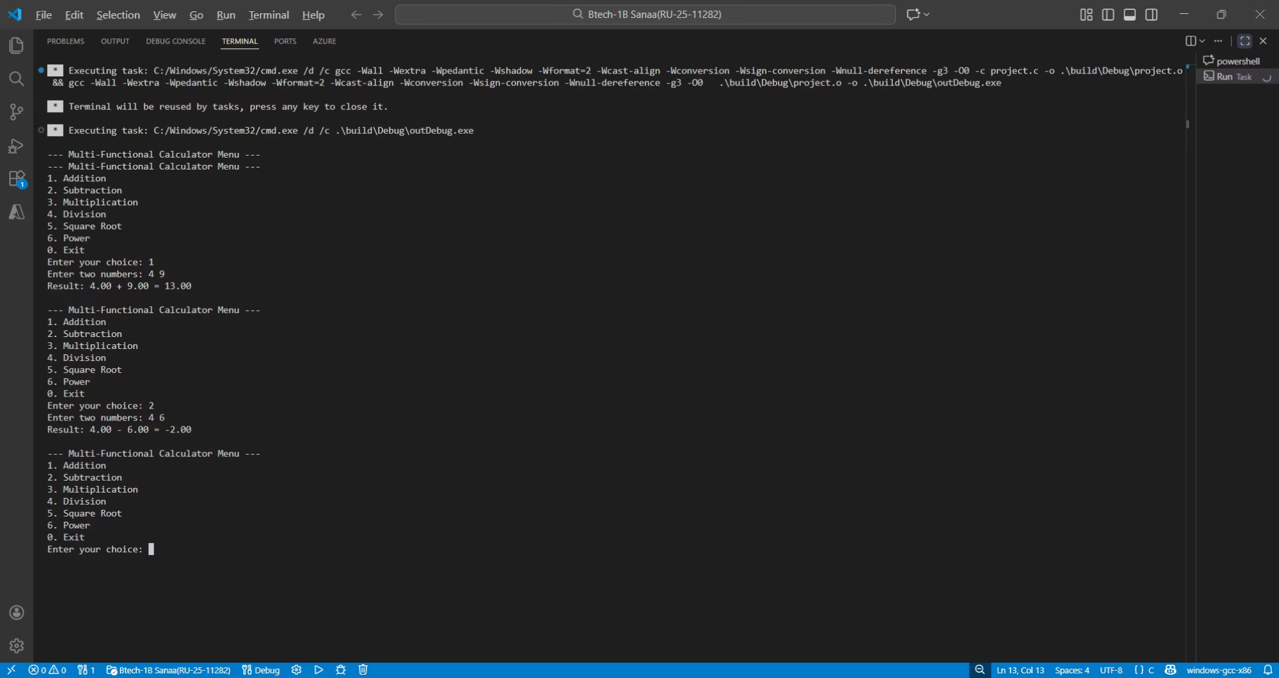
OUTPUT

Slide 8


Project Working
Screenshot / Screen Recording
Live demonstration showcasing the calculator's interface, menu system, various mathematical operations, and output formatting in action.
Programme Flow
1
Display Main Menu
Show available operations to user
2
Accept User Choice
Input validation and operation selection
3
Get Input Values
Prompt for required operands
4
Perform Calculation
Execute selected mathematical operation
5
Display Result
Output formatted result to console

Slide 9




Core Logic & Algorithm
Input Validation
Menu-Driven Interface
Scanf() function captures user input with error checking. Validation ensures numerical inputs are within acceptable ranges and handles non-numeric entries gracefully.
Switch-case statement implements operation selection, providing a clean and organised user experience with numbered choices for each mathematical function.
Result Processing
Mathematical Operations
If-else conditionals handle special cases like division by zero. Printf() displays formatted results with appropriate decimal precision using format specifiers.
Functions utilise arithmetic operators (+, -, *, /) and math.h library functions (pow, sqrt, sin, cos) to perform calculations with precision and efficiency.

Slide 10




Applications
Educational Learning
Scientific Computing
Daily Computations
Competitive Programming
Excellent tool for students learning C programming concepts, demonstrating practical implementation of functions, control structures, and mathematical operations.
Quick calculations for scientific experiments, engineering problems, and statistical analysis without requiring complex software applications.
Simple and efficient solution for everyday mathematical needs, from basic arithmetic to advanced trigonometric and exponential calculations.
Foundation for understanding algorithmic problem-solving, serving as a building block for more complex computational projects and coding challenges.

Slide 11
Key Advantages
Simplicity & Efficiency
Educational Value
User-Friendly Interface
Clean, straightforward implementation with minimal code complexity. Fast execution time ensures quick calculations without performance overhead.
Demonstrates fundamental C programming concepts including functions, switch statements, input/output operations, and mathematical libraries in a practical context.
Intuitive menu-driven design makes the calculator accessible to users with minimal technical knowledge. Clear prompts guide users through each operation.
Comprehensive Functionality
Portable & Lightweight
Console-based application requires minimal system resources and can run on various platforms without dependencies on external libraries or frameworks.
Supports multiple mathematical operations from basic arithmetic to advanced scientific functions, providing versatile computational capabilities in a single application.

Slide 12

Future Scope
Graphical User Interface
Develop a GUI-based version using graphics libraries for enhanced visual appeal and improved user interaction.
Advanced Functions
Integrate matrix operations, calculus functions (derivatives, integrals), and statistical analysis capabilities for complex mathematical computations.
Calculation History
Implement file handling to save and retrieve previous calculations, enabling users to maintain a record of their computational work.
Expression Parsing
Add capability to evaluate complete mathematical expressions (e.g., "2 + 3 * 5") using expression parsing algorithms and data structures.
Unit Conversions
Expand functionality to include unit conversion features for length, weight, temperature, currency, and other measurement systems.
"The Multi-Functional Calculator project demonstrates the power and versatility of C programming whilst providing a solid foundation for future technological enhancements."

